Slide 1
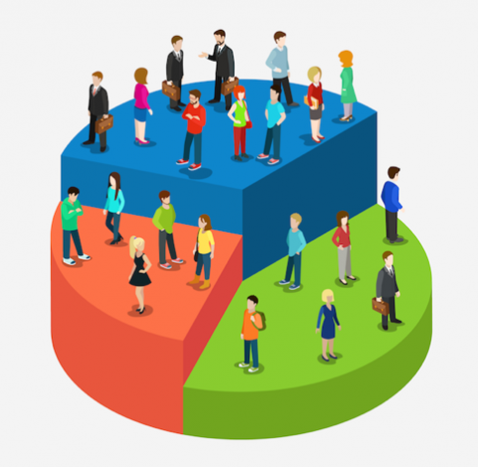
Customer Segmentation
Submitted By:
Rishav Rana

Slide 2

Customer segmentation is the process of dividing a company's customer base into distinct subgroups or segments based on specific characteristics such as demographics, behavior, preferences, and purchasing patterns. The goal of customer segmentation is to better understand customers and create targeted marketing campaigns that appeal to each segment's unique needs and interests.
By segmenting customers, companies can tailor their marketing efforts to each group's preferences and maximize the effectiveness of their marketing budget. Common methods used to segment customers include geographic, demographic, psychographic, and behavioral segmentation.
Customer Segmentation

Slide 3

Importance of Customer Segmentation :
Better targeting: By using customer segmentation, firms may target particular client segments with advertising messages and merchandise. By creating targeted campaigns, businesses can increase the effectiveness of their marketing operations and their return on investment.
Customer retention: Businesses can identify their most valuable customers through customer segmentation, and then develop retention strategies to keep them coming back. Understanding customers' needs and preferences can help businesses offer them individualized experiences that encourage them to come back.

Slide 4
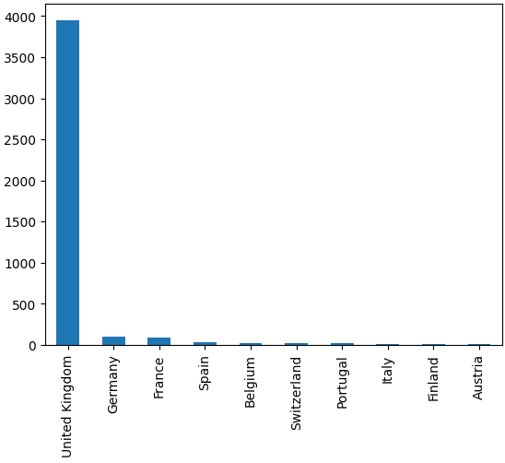
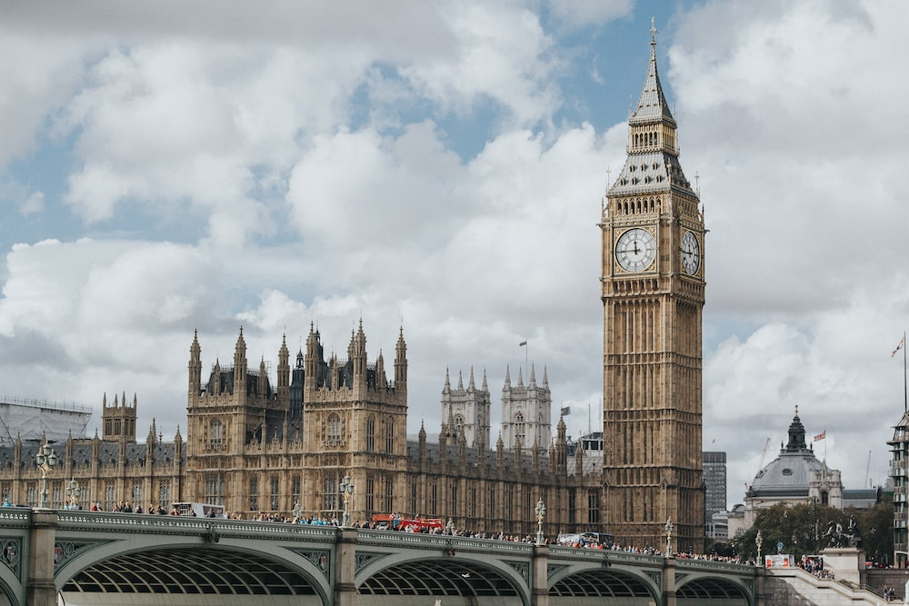
Top 10 Country Data
The United Kingdom likely has return clients and the biggest sales, followed by Germany and France, according to this bar chart.
The United Kingdom maintains its dominant position in the market by selling more products of superior quality than other countries.

Slide 5
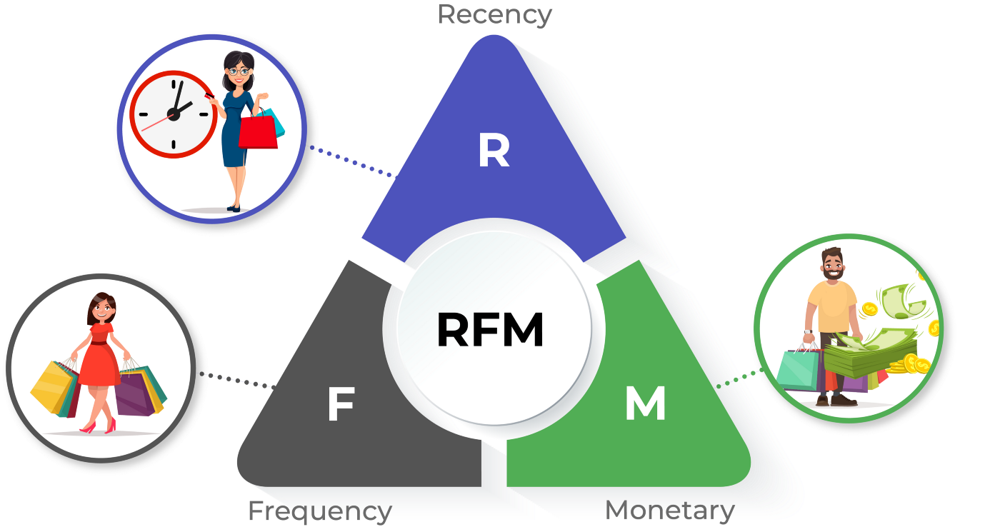
RFM Analysis

Slide 6
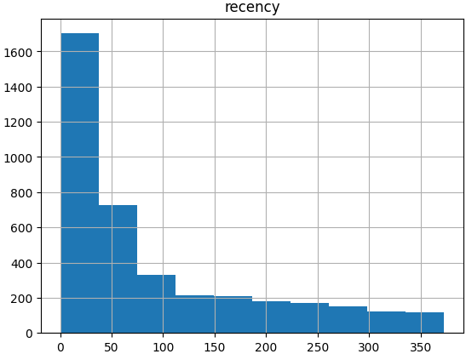
Histogram For Recency of UK :
The graph above, which goes from 0 to 50, shows that there are numerous significant spikes, indicating that the clients are quite recent.
This graph shows that during the past 40 days, we have conducted business with more than 1600 different customers.
The declining trend suggests that most of our customers have recently made purchases from us, with only a small minority of customers failing to do so.

Slide 7
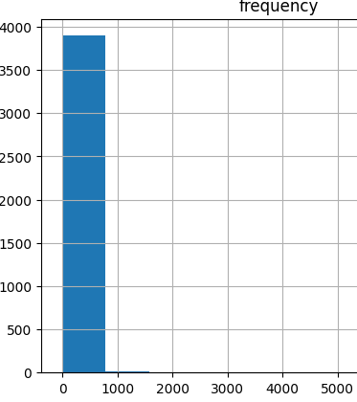
Histogram chart for Frequency data for UK .
The Histogram Chart makes it evident that customers visit frequently, as can be seen.
The value of 5000 on the frequency axis may be an outlier because all of the data is collected on the left side between 0-1000.

Slide 8
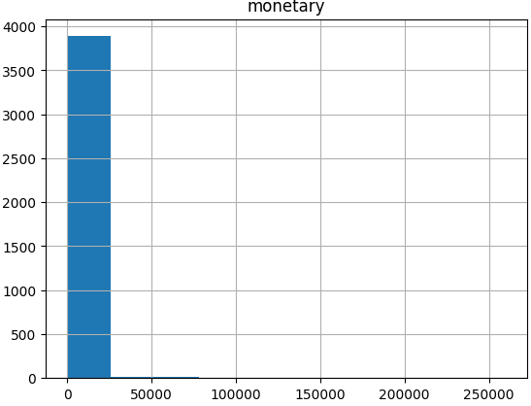
Histogram chart for Monetary Data of UK:
The monetary axis in the graph above has a strange limit of $250,000. Clients typically spend between 0 and 25,000, as far as we can ascertain.
We can see that the right skew indicates that there are outliers in the financial column.

Slide 9
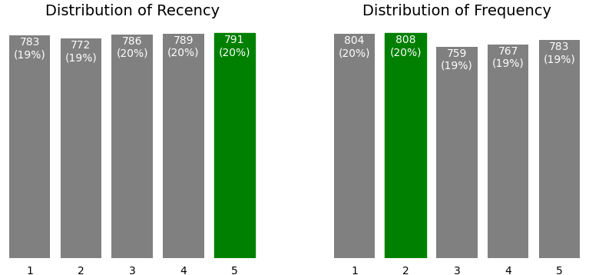
Distribution of customer over Recency & Frequency
The graph shows that most clients were not regular but rather recent.
The number of clients in the various ranks varies only slightly overall, and we may use marketing efforts to target the rank 1 and 2 customers and raise their rankings.

Slide 10
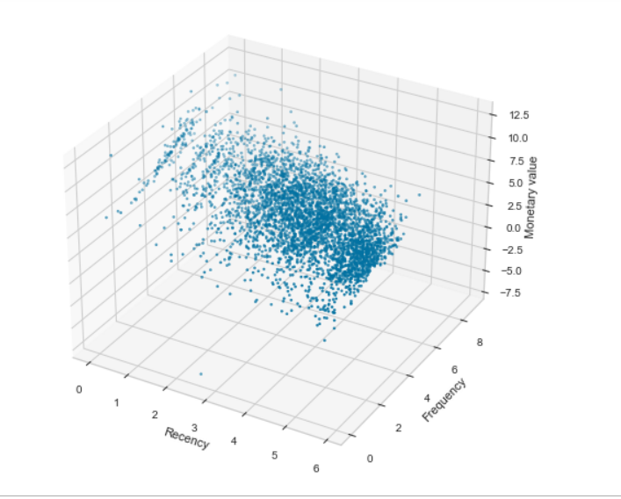
RFM CUBE
From the given graph one can see that customer who are more frequent and more recent tends to spend more based on the increasing trend in monetary value.

Slide 11
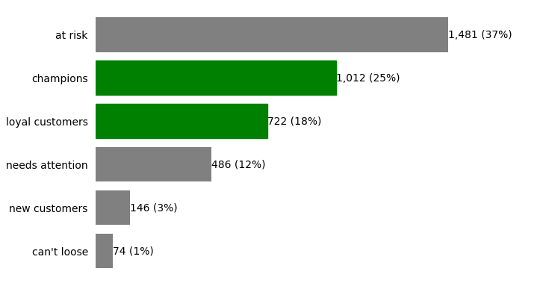
Customer segmentation
The graph shows that the majority of our clients are classified as being "at risk."
We must conduct marketing initiatives to persuade the "at risk" customers to purchase more frequently and recently.

Slide 12
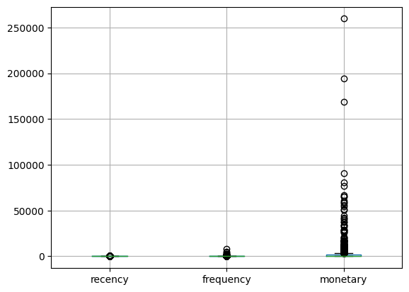
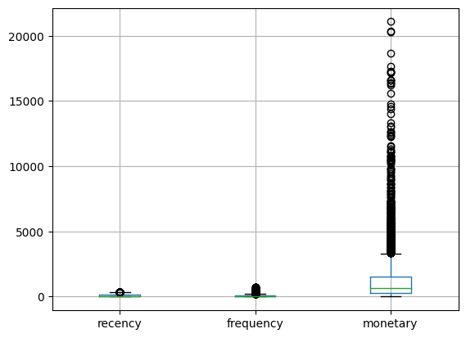
Treating outliers using Z-scores
As one can see, after eliminating the outliers, the distributions become clearer.
Recency, frequency, and monetary scales all have quite different ranges. The stack for recency and frequency is still present. We could develop individual box plots to investigate this further

Slide 13
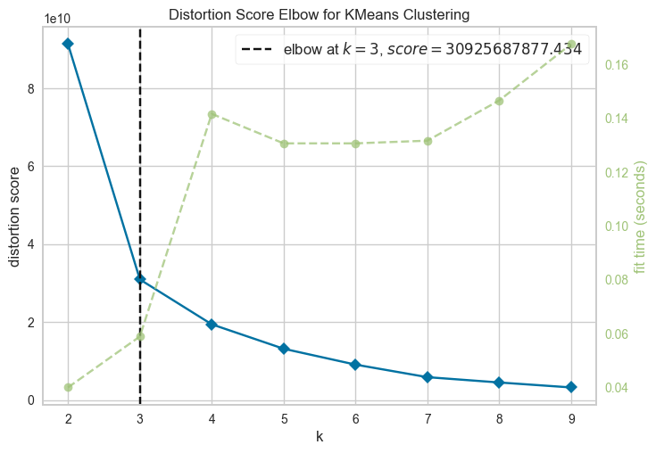
Clustering analysis
When an elbow plot is produced using our RFM data frame, the elbow is displayed at 3. This indicates that we can obtain 3 separate client clusters in our data. By visualizing these clusters, we can better target consumer groups and raise their RFM rankings.

Slide 14
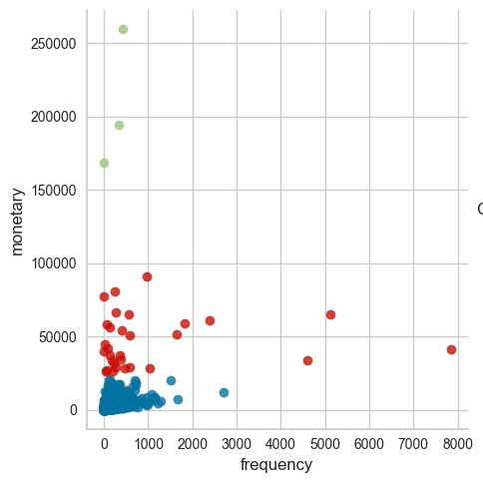
Recommendation
In this plot we can see that cluster 0(blue) has customers with low monetary transactions and low frequency. This plot can help us target these customers with marketing campaigns.

Slide 15
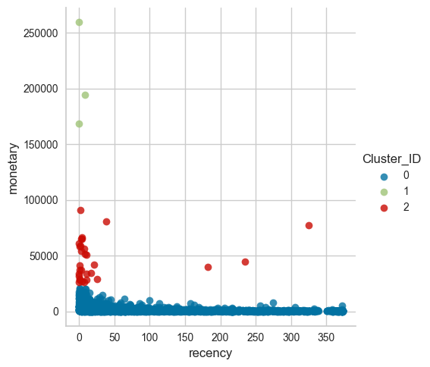
Recommendation
We can see from this figure that clients in cluster 0 (blue color) have less recency and less monetary. To increase their financial transactions, we can target the cluster 0 customers on the left using this graphic. Therefore, a different campaign needs to be focused on the clients in cluster 0 to the right in order to increase monetary and recency.

Slide 16

Conclusion
We have a solid understanding of the client IDs that need to be targeted to grow the business based on the study and customer segmentation.
To try to increase the customer ranks, our next action should be to execute a marketing campaign targeted to each segment.
We should conduct this study once more at the campaign's conclusion to determine its success.

